Slide 1


Equipped to tell your Story
Aroha Atu

Slide 2
What’s this all about?
(and why should I be excited about this?)

Slide 3
Stories are ALL around us
They inform us about the world around us
They help us make sense of the world
They help us share abstract ideas
They inspire us
They change us
Good stories lead to action

Slide 4

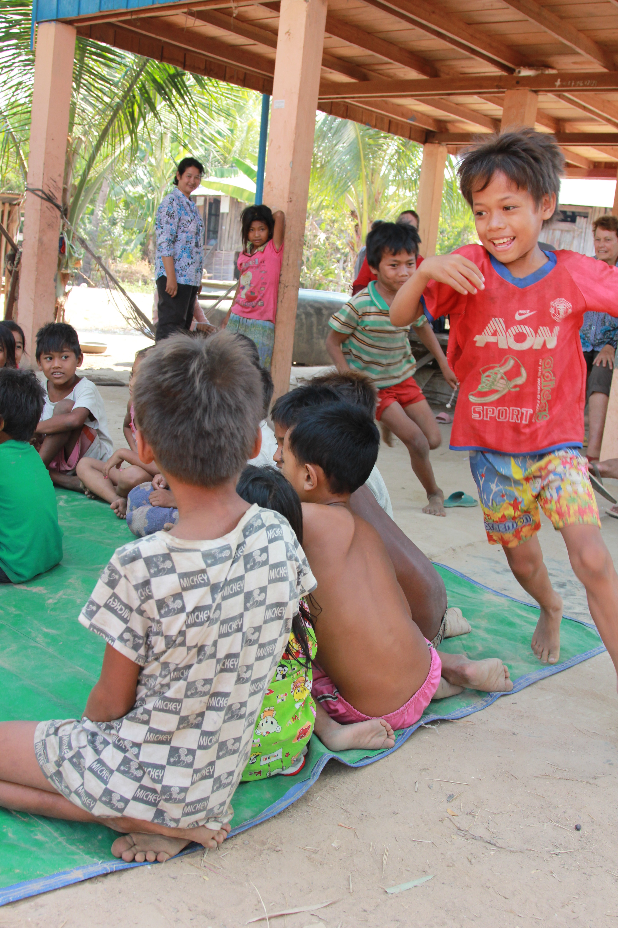


Slide 5

The greatest story ever told
The greatest story you could ever tell

Slide 6
1) Before the Story
Understanding what you need before you tell your story and how to monitor, evaluate, and report on your stories.
2) How to tell a Story
Practical tools and resources on how to tell a story.
3) Sharing your Story
Your potential for growing your community project and using it as a discipleship tool.

Slide 7
Before the Story
Monitoring, Evaluating, and Reporting

Slide 8
Before the Story
In the designing phase of a community project, consider these questions.
Who need to hear your stories?
Who needs a report and what is it’s purpose?
How will you collect your stories?
What methods will you use to track your progress?

Slide 9
Monitoring
Monitoring is regular maintenance, ensuring you are checking the progress of your project.
Evaluating
Evaluating is making a judgement about your project based on your goals.
Reporting
Reporting is presenting the impact of your project.

Slide 10
Before the Story
Consider the Requirements of the Funder or expectation of your church/community
What has been done during this reporting period?
Refer to the application form for this project, and report against the aims and objectives stated in your CTP application that would be done. This is likely to include things like: number of participants, who were the participants, number of meetings or trainings, etc.
What has worked well during the reporting period, and what might you do differently next time?
It is important to identify what went well, as these are practices you would want to continue or do again. Equally, it is important to identify what didn’t work well, and to learn from this to identify how you would do things next time.
What will be done during the next reporting period
Based on your experiences in the first reporting period, and any lessons learnt, plus what you application says you will do, outline what you expect will be done in the next reporting period.
Was the aim of the project met? If so, how? If not, why not?
It is important to know if you are achieving what you set out to achieve, as given in your application form, and if not what might be causing this.
How many volunteer hours have been utilised towards this project?
You may use the following table as a guideline to help calculate this.

Slide 11
Before the Story
Tools of the trade
Survey Monkey – free survey tool
Stats NZ - Demographic information
Menti.com – word map, quiz, and survey
Social Media – polls and reach

Slide 12
Before the Story
Getting this phase right ensures:
It’s easier to collect the right stories
You and your team are kept accountable
You are able to make adjustments
You are able to make the best impact in your community

Slide 13
How to tell a story
To make the greatest impact

Slide 14
How to tell a story
Q. How many ads do you see a day?
A. Between 4000-10000

Slide 15
How to tell a story
Q. How long does it take for someone to decide whether they are going to keep watching a video?
A. 3 seconds

Slide 16
How to tell a story
Reality: There is a growing abundance of information available
Experiment Time!
2 awesome Champion volunteers needed

Slide 17


How to tell a story
Reality: There is a growing abundance of information available
Elevator Pitch: Can you tell your story in an elevator?
Napkin Test: Can you fit your story on a napkin?

Slide 18
How to tell a story
What makes a good story?
Person-centric
Follows a good structure
Opportunity to respond

Slide 19
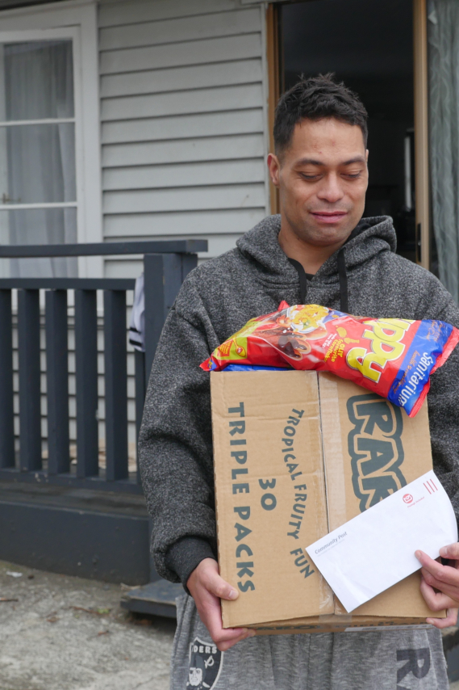
How to tell a story
A person centric story
A persons story should be personable!

Slide 20
How to tell a story
Story Structure
What was life like before?
What happened?
What is life like now?

Slide 21
How to tell a story
Tools of the Trade
Genuine connection and investment in someone’s story
Recognise that for many people, their stories are a sacred space
Writing and Interviewing skills
Use people who are in that space with those skill sets
Photos, one picture speaks a thousand words
Videos, showcases the situation and makes a persons story come to life.
Consider what is more powerful for which platform

Slide 22
How to tell a story
Photos
Use the tools you have in front of you
Make it about the person
Experiment & Practice
Helpful resources:
Basic: time.com/5660278/smartphone-camera-picture-tips
More technical: blog.hubspot.com/marketing/good-pictures-phone-tips

Slide 23
How to tell a story
Video’s
Have your questions and shots planned

Slide 24
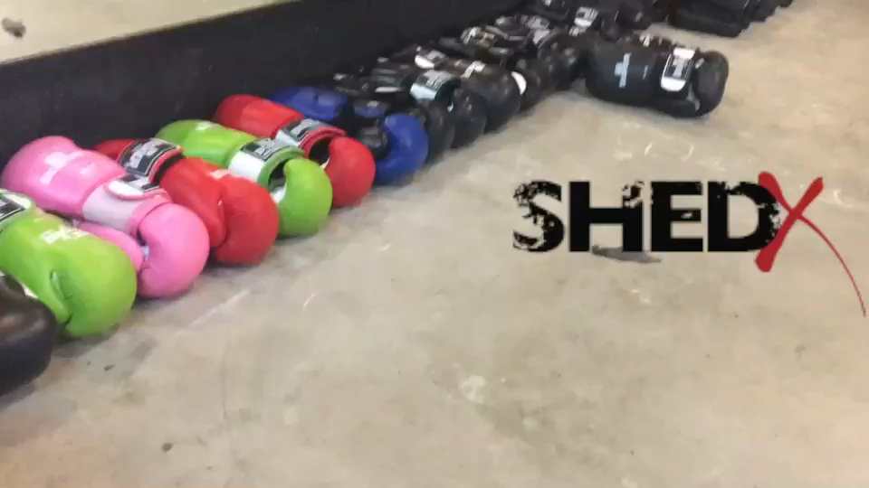
How to tell a story

Slide 25
Sharing your Story
To inspire others

Slide 26
Sharing your Story
Leverage your Resources
Consider multiple platforms and way’s to use your story
  Reporting
  Church
  Social Media

Slide 27
Sharing your Story
Everybody has a story – yes, including you!
Your story can glorify God
Your story can inspire others
Your story can help you grow

Slide 28
Next Steps
What will you do now?
Identify one story from your life and one story from a community or church project that you resonate with
Write the story on a napkin
List down how this story can be used in helpful ways
Make a plan to write and present this story

Slide 29
Next Steps
“Go home to your people and tell them how much the Lord has done for you, and how He has had mercy on you.”
Mark 5:19

